Slide 1
LIS 6603 Summer 2017 Dr. Hong Huang Created By:
LIBGuide PowerPoint:
Dawn Parker
Mitzi Mack
Susan Turpyn

Slide 2
Title:
Children’s Summer Reading Fun and Library Activities

Slide 3
Introduction:
Welcome to Summer Reading Fun and Library Activities!
This presentation is to give you an overview of the LIBGuide and it’s contents. It is a brief synopsis of some information and reading activities that you might find interesting and fun to do this summer.

Slide 4
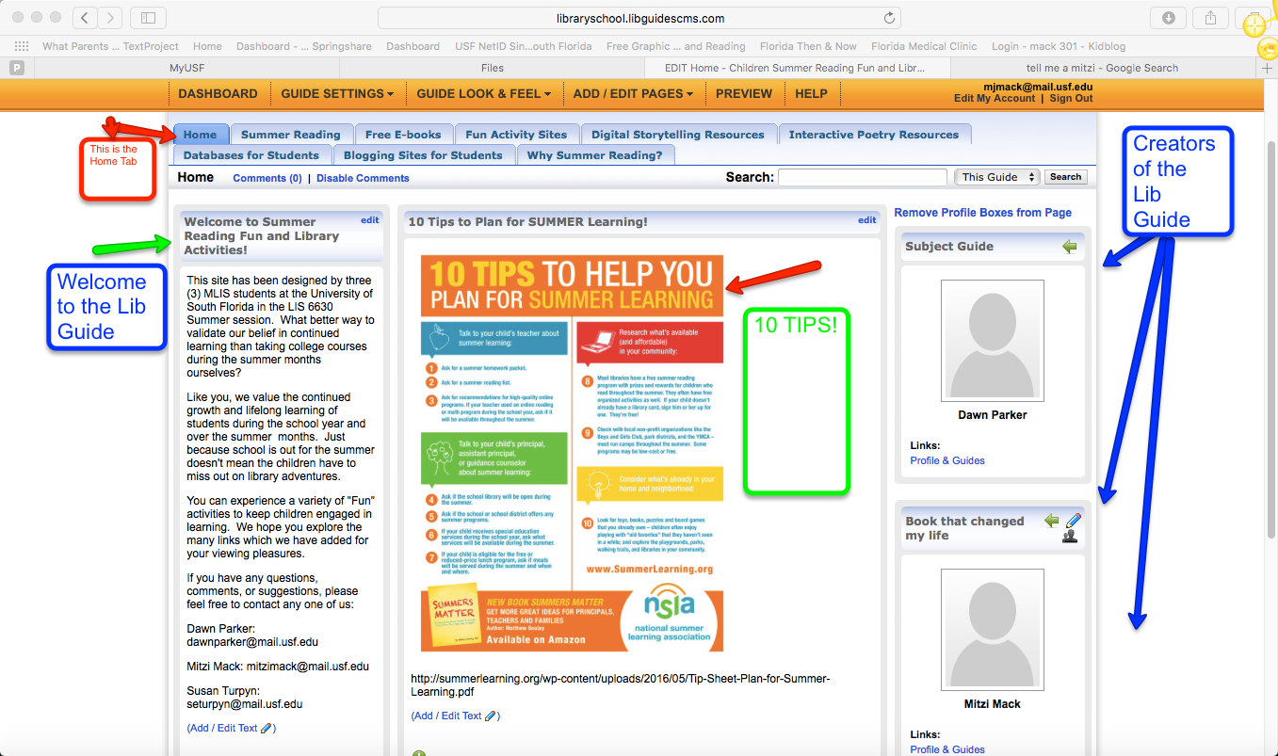
Home Tab:
10 tips to help you plan for Summer Learning. We however, have done some of the steps for you!
You will find loads of information in each tab of the LIBGuide!

Slide 5
Summer Reading:
Within this tab you will find activities that you can participate in. All sections have quick links that will take you directly to the specific sites.
Some of the sites are:
Barnes and Noble Books for Kids
Day by Day Reading
Books A Million
Scholastic Summer Reading Challenge 2017
My ON Summer Reading Challenge!
Tumble Books

Slide 6
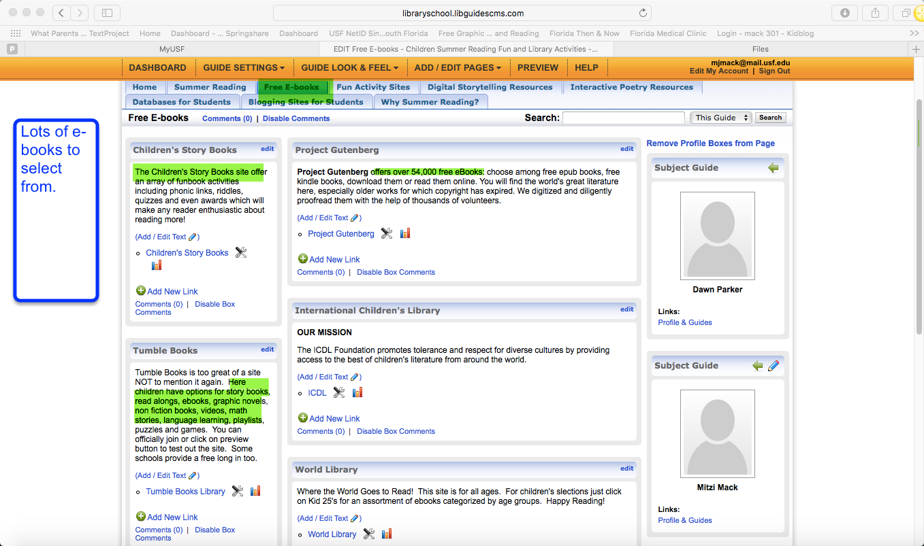
Free E-books:
FREE FREE FREE FREE
The next tab in our LIBGuide offers several links to e-books. These links will give children thousands of books to choose from.
Children can browse for e-books at sites such as:
International Children’s Library
World Library
Tumble Books (this site is so great we just had to mention it again!)
Project Gutenberg and Children’s Story Books

Slide 7
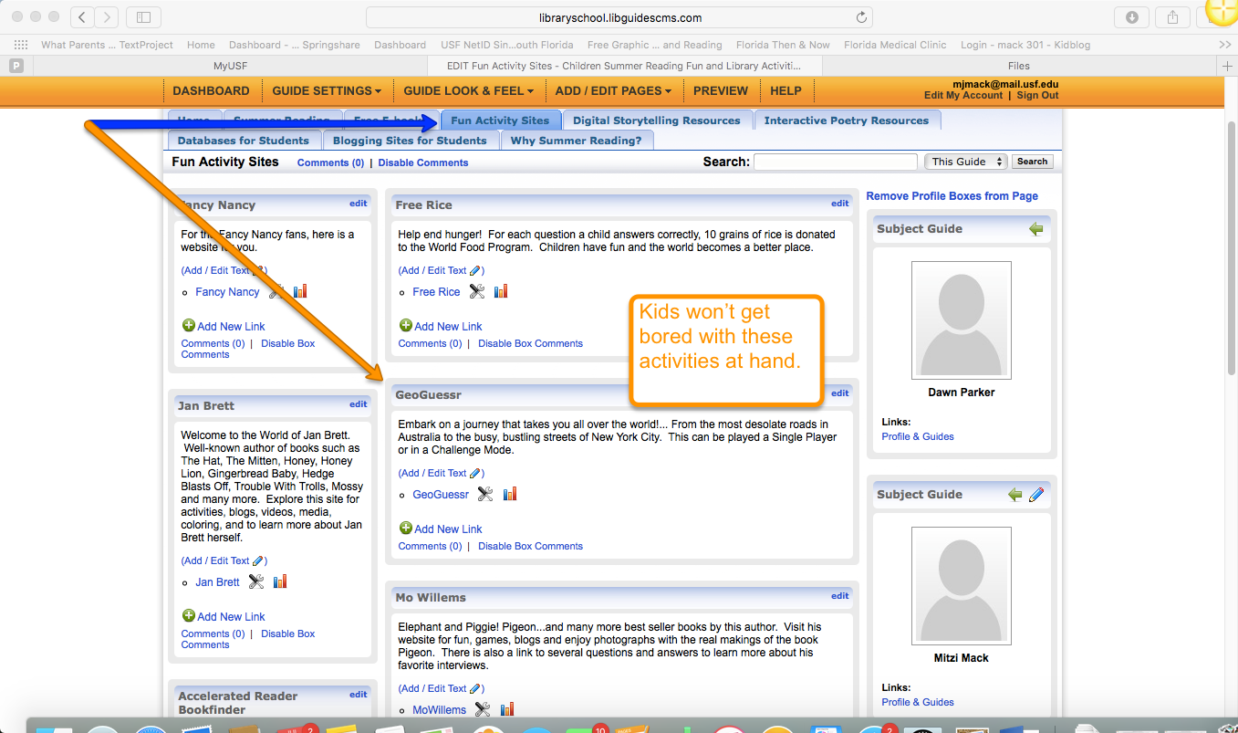
Fun Activity Sites:
Our next tab or section in the LIBGuide has several sites where you will find fun activities. Boredom should not be in your vocabulary if you visit some of these links!
Weavesilk-Drawing will have you amazed at what you can draw; and PBS Kids will help you to get Media Smart!
Embark on a journey that takes you all over the world with Geo-Guessr. This is a game that can be played as a single player or in a challenge mode.
Check out this tab to find many more fun activities!

Slide 8
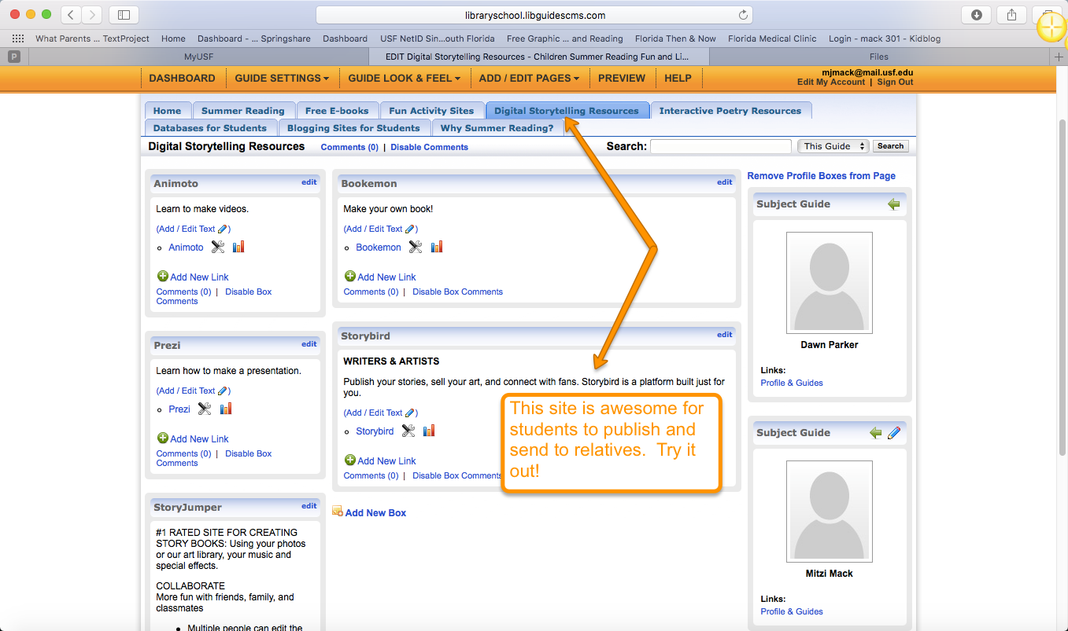
Digital Storytelling Resources:
Attention all writers and illustrators! This section has several links to resources on how to create your own videos, books and presentations.
Check out Storybird, where you can publish your stories, sell your art and connect with fans. This is a great platform for writer’s and artists!
You will also find links to:
Prezi
Animoto
Bookemon and StoryJumper

Slide 9
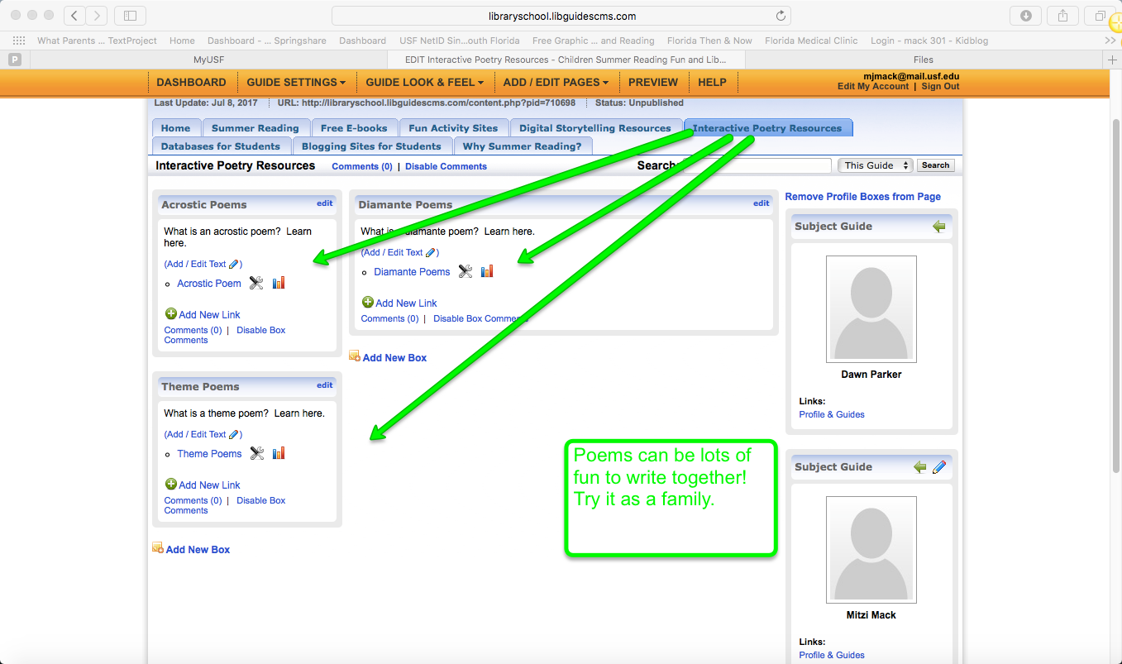
Interactive Poetry Resources:
This section is all about Poetry! Here children can learn about different styles of poetry. Become an expert on styles like Acrostic, Diamante and Theme poetry!

Slide 10
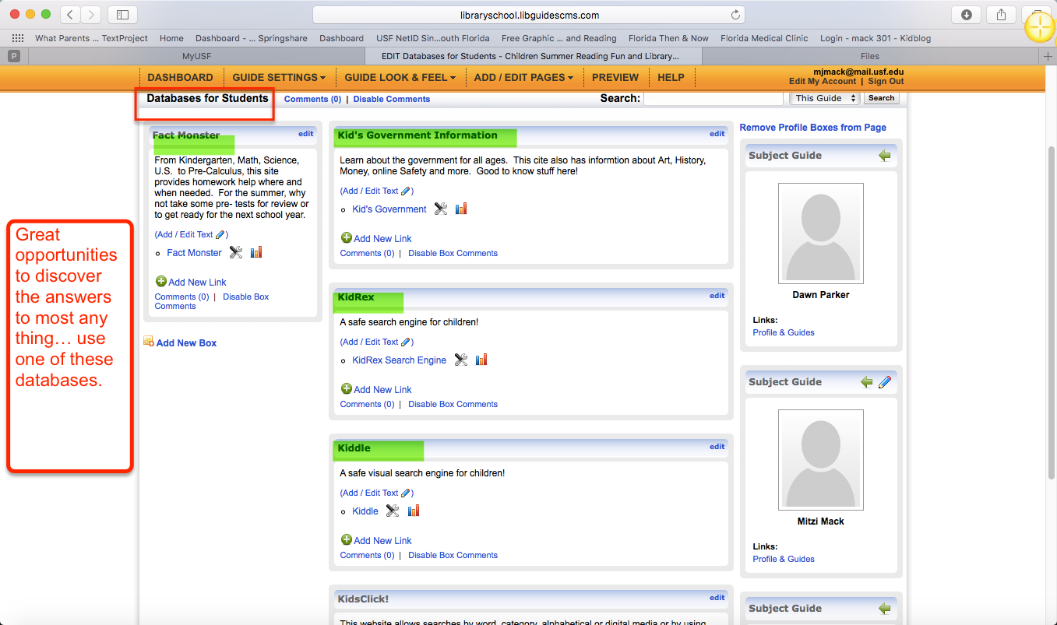
Databases for Students:
This tab is a great resource! These links give children safe places to search and do research.
This is a list of a few databases to choose from:
KidsClick!
Kiddle
KidRex
Fact Monster and
Kid’s Government Information

Slide 11
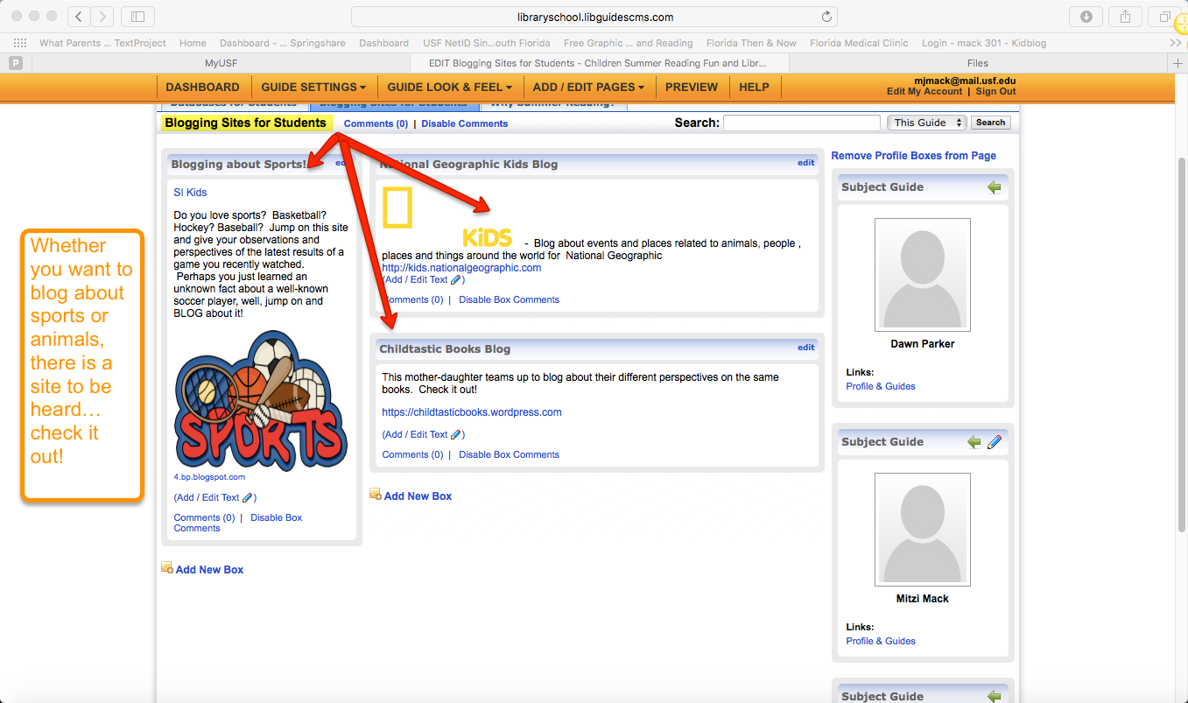
Blogging Sites for Students:
Blogging gives children the opportunity to discuss issues of interest to them with other children in a safe environment.
This tab has a selection of sites to choose from such as:
SI Kids (where kids can blog about sports)
National Geographic Kids Blog
Childtastic Books (a mother-daughter teams up to blog about their perspectives on the same book)
Go check these out and let your voice be heard!

Slide 12
Why Summer Reading?
This tab gives the rationale for the importance of summer reading. Many studies have been conducted (and are still being conducted) to investigate the effects of summer break and the learning loss that occurs. Researchers call this learning loss the “summer slide”, where children could possibly lose up to a full reading level if they don’t participate in learning activities during the summer break.
The sites found in this tab give insight to the studies that are being or have been conducted regarding this issue and the importance of summer reading programs and activities.

Slide 13
Conclusion: Library Guide
We hope that you have found our LIBGuide to be helpful and one that you would like to explore more in-depth, whether it be for your own use or to use with your children or students.
If you have questions, please feel free to contact one of us.
Dawn Parker (roles: LIBGuide Coordinator, PowerPoint Completer Finisher)
Mitzi Mack (roles: LIBGuide Monitor Evaluator, PowerPoint Monitor Evaluator)
Susan Turpyn (roles: LIBGuide Completer Finisher, PowerPoint Coordinator)

Slide 14
Behind the scenes - Design of the Guide:
Teamwork created this guide: writing, editing, and checking resources. Dawn coordinated and created the guide on the site and began inserting tabs, information and links. Mitzi added more information and links. Susan also put her spin on the development, with still more resources and checked for errors in the process.
For this PowerPoint, Susan coordinated the draft, Mitzi gave her input and Dawn tweaked it more to include the narration and some more colors and added more slides to account for a longer presentation.

Slide 15
There are over thirty (30) resource items included.
A statement about the scope of the project describes the targeted audience as children with the assistance of their parent(s) and or teacher(s) on the home page.
Each tab, also known as library subject headings, allows quick access to the desired area of interest, for example, if a child wants to learn how to create their own video, they would go to the Digital Storytelling Resources tab.
Careful consideration went into the actual websites and resources used, with child safety in mind/age appropriate. We only used resources that we were already familiar with due to past or present experiences working with children.

Slide 16
We also discussed the importance of providing free materials, as we understand that some families are not able to provide for their child(ren) during the non-school year.
The entire guide has easy access links that with a simple click the user will be immediately transferred to the website of their choice.

Slide 17
Some Learning Lessons:
Developing the project took a lot of communication on each member’s part. A majority of our information was shared via emails, with a few texts here and there. We sent emails through the USF mail box, as the group discussion session did not work for us. Times could have been coordinated more effectively, but we all have other priorities and commitments. Overall, we managed to work around our schedules and provide an awesome LIBGuide.

Slide 18
Due to the other commitments we also made it work to our advantage and found that reversing roles for the coordinating/providing the beginning stages, and providing the finishing touches worked for us as well. Again, communication was the key to putting the pieces of the puzzle together.
We all worked well together. We did not encounter any negative feedback, in general. Some of the links provided were no longer working, but tweaking and re-adjusting was not a problem. All ideas were considered, nothing rejected.
As for the lessons learned from the topic itself, although aimed at children, each of us probably learned some new information about the topic. “I know I did!”

Slide 19
Thank you

